Slide 1

HOME CREDIT RISK ANALYSIS
Bhakti Dahal | Andrew Moore
Disha Tapadiya | Venkatachalam Kapuganti
Notes:
INTRODUCTION: Introduce team members

Slide 2


BUSINESS PROBLEM
PROVIDE LOANS TO THOSE WITH LITTLE TO NO CREDIT HISTORY
HIGHER RISK OF DEFAULT
Notes:
BUSINESS PROBLEM & PURPOSE OF THE PROJECT: Discuss what Home Credit is, how they make money, how they compete against traditional loan companies.

Slide 3
Can we reduce the loan default risk for Home Credit?
Notes:
MODEL IMPACT ON BOTTOM LINE: How will model performance translate to additional revenue and/or profit for Home Credit

Slide 4
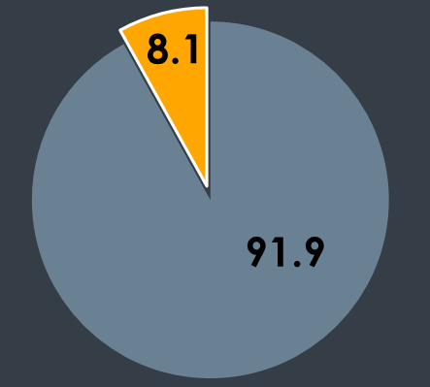
LOAN DEFAULT OR NOT
% Default
% No Default
Notes:
MAJORITY CLASS: Discuss that currently, 8% of issued loans default.

Slide 5
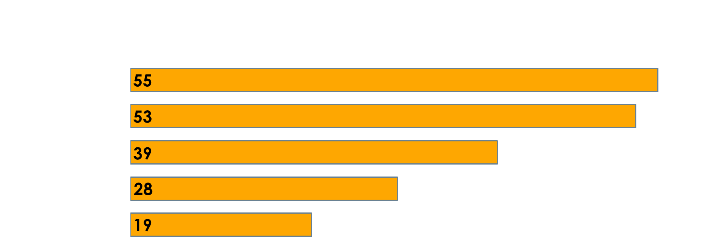
TOP PREDICTORS
Notes:
PREDICTORS: Home Credit supplied over 100 attributes for each application! Which of these attributes are actually useful? Here, we list some of the most influential predictors that determine if an applicant is likely to default on their potential loan.

Slide 6
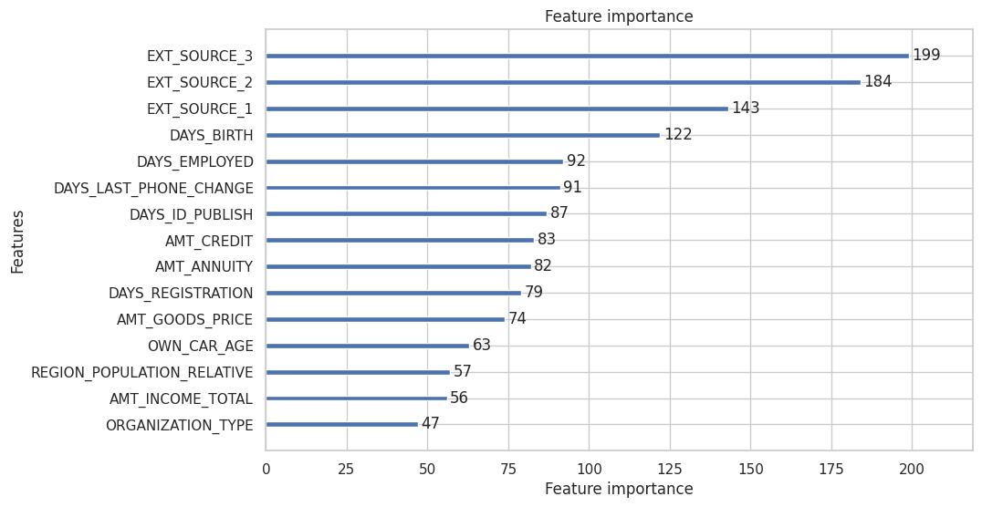
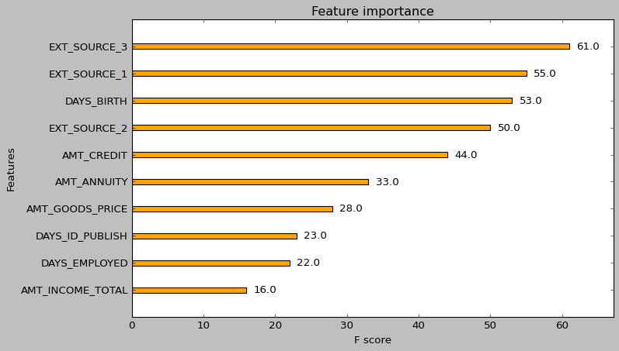
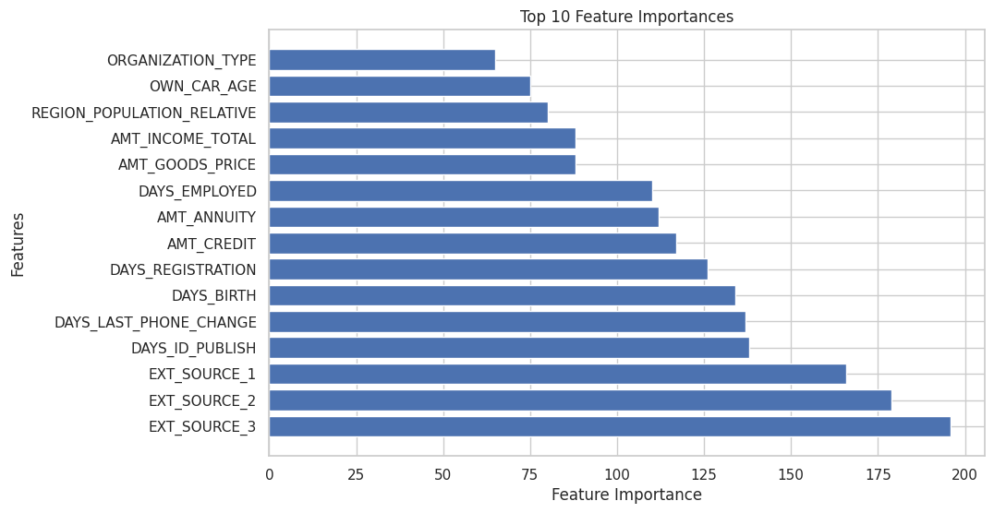

Slide 7
MODEL SELECTION
XGB Classifier
LightGBM Classifier
Random Forest
Logistic Regression

Slide 8



RESULTS
0.6745
0.7162
0.8482
Kaggle Score
Accuracy
AUC-ROC
Notes:
Discuss Model Performance ?

Slide 9


HOME CREDIT PERFORMANCE: WITH MODEL
Revenue
Profit Margin
Notes:
ANDREW | MODEL IMPACT:
You may be asking yourself, why would we want a model that has a lower accuracy than the majority predictor? When it comes to the loan business, the cost of issuing a loan that defaults is significantly higher than the profit from writing a single successful loan. You may need to write 5….10……25 successful loans to have enough profit to cover one bad loan.
While this may decrease overall revenue as Home Credit writes fewer loans; however, this will increase Home Credit’s profit margin.

Slide 10
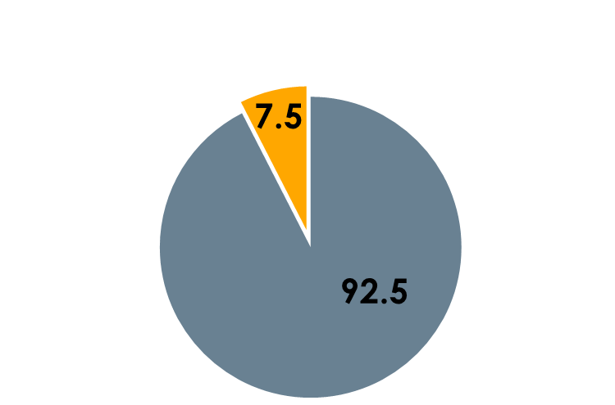
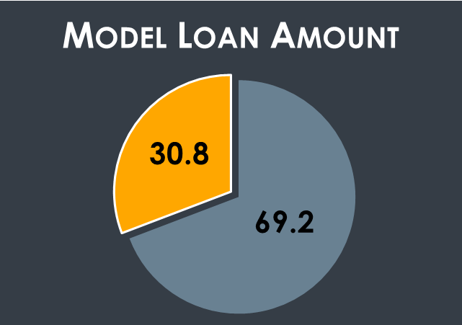
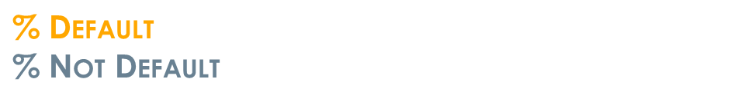
Notes:
ANDREW | PRACTICAL RESULTS:
Here is a break down of the value of loans issued. Only 7.5% of the value of total loans default.
Our model will label 30% of loan valuations as default. This overweighting of the default classification will help Home Credit avoid more toxic loans.

Slide 11


RECOMMENDATION
Implement the model
Additional Predictors
Notes:
ANDREW | Recomendation
IMPLEMENT THE MODEL
Run the old model to compare the impact to Home Credit’s profit margin
UPGRADE THE MODEL
New information provided on Home Credit loan applications
Future market data acquisition
Required to stay competitive

Slide 12
THANK YOU!

